Slide 2
Eleventh Street Baptist Church
EXALTING GOD…
Extending God’s Love
Evangelizing the Lost
Edifying the Body
Equipping the Saints
TO SERVE THE LORD!

Slide 3
ABOUT BAPTISM AND THE CHURCH
The ABC’s of Eleventh Street Baptist Church

Slide 4
THE MEANING OF CHURCH MEMBERSHIP
ABOUT BAPTISM AND THE CHURCH
The ABC’s of Eleventh Street Baptist Church

Slide 5
Everyone who has accepted Christ as Lord and who has been baptized should also become a member of a local church.
Becoming a church member involves committing oneself to participate in the local church.

Slide 6
THE MEANING OF “CHURCH”
1. In modern English we use the word “church” in some ways that are different from the way the word is used in the Bible.

Slide 7
Presbyterian Church
Catholic Church
Baptist Church
Methodist Church
A BUILDING
A DENOMINATION

Slide 8
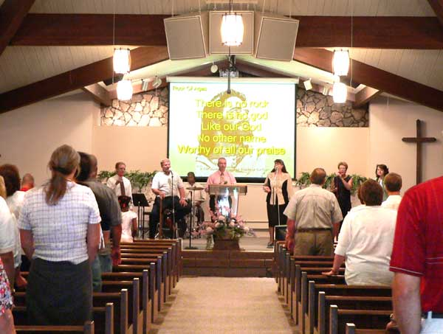
A WORSHIP SERVICE

Slide 9
THE MEANING OF “CHURCH”
2. The word “church” in our English Bibles is translated from the Greek word ekklesia.
This word refers to the gathering or assembly of a particular group of people, usually for a specific purpose.

Slide 10
So then, some were shouting one thing and some another, for the ASSEMBLY [ekklesia] was in confusion…
Acts 19:32 NASB
But if you want anything beyond this, it shall be settled in the lawful ASSEMBLY [ekklesia].
Acts 19:39 NASB

Slide 11
THE MEANING OF “CHURCH”
3. Christians borrowed the word ekklesia to describe the gathering together of believers in Jesus Christ.
In the New Testament, “church” primarily means: Christians joining together to worship and serve the Lord.

Slide 12
THE MEANING OF “CHURCH”
4. In the New Testament, “church” (ekklesia) is occasionally used to refer to all Christians everywhere, as a whole. This is the universal church.
But you have come…to the church, composed of all those registered in heaven… from Hebrews 12:22-23 LB

Slide 13
THE MEANING OF “CHURCH”
5. In the New Testament, “church” (ekklesia) is most often used to refer to a group of Christians who literally gather together in a specific location. This is the local church.
From Paul, chosen by God to be an apostle of Christ Jesus, and from Sosthenes, who is also a follower. To God’s church IN CORINTH. 1 Corinthians 1:1-2 CEV

Slide 14
THE MEANING OF “CHURCH”
6. In the New Testament, “church” never refers to a building or a denomination.
It always refers to people who believe in Jesus and gather in His name.

Slide 15
THE MEANING OF “CHURCH”
7. Personal participation is basic to the meaning of “church” in the New Testament.
To become a member of a church means to join and participate with other Christians who gather together to worship and serve the Lord.

Slide 16
THE MEANING OF “MEMBERSHIP”
1. In the New Testament, the church is described as Christ’s body, in which individual Christians are the various parts of the body.
Now you are Christ’s BODY, and individually MEMBERS of it.
1 Corinthians 12:27 NASB

Slide 17
THE MEANING OF “MEMBERSHIP”
This is the only kind of church “membership” referred to in the New Testament.
2. To become a member of a church does not mean joining a religious organization. It means active participation in a living, spiritual organism.

Slide 18
THE MEANING OF “MEMBERSHIP”
3. Your body has many parts, but they all work together as a unit. Similarly, the church has many members, but it is God’s purpose that they work very closely together as a unified whole.
The body is a unit, though it is made up of many parts; and though all its parts are many, they form one body. So it is with Christ. 1 Corinthians 12:12 NIV

Slide 19
THE MEANING OF “MEMBERSHIP”
4. A part of the body cut off from the rest of the body becomes lifeless and useless.
Similarly, Christians who detach themselves from the frequent fellowship of other Christians endanger their spiritual life and become spiritually unuseful.

Slide 20
THE MEANING OF “MEMBERSHIP”
Some people have gotten out of the habit of meeting for worship, but we must not do that. We should keep on encouraging each other…
Hebrews 10:25 CEV

Slide 21
THE MEANING OF “MEMBERSHIP”
5. Active participation is basic to the meaning of membership in the New Testament.
To become a member of a church means to join and participate with other members in a body of believers under the Headship of Jesus Christ.

Slide 22
THE MEANING OF KOINONIA
1. The kind of participation members are to have in the church is described in the New Testament by the Greek word koinonia.
They devoted themselves to the apostles' teaching and to the fellowship [koinonia], to the breaking of bread and to prayer.
Acts 2:42

Slide 23
THE MEANING OF KOINONIA
2. Koinonia can be translated:
participation,
fellowship,
sharing,
association,
partnership,
close relationship.

Slide 24
THE MEANING OF KOINONIA
3. We must first have koinonia with God and Christ.
What we have seen and heard we announce to you also, so that you will join with us in the fellowship [koinonia] that we have with the Father and with his Son Jesus Christ. I John 1:3 TEV

Slide 25
THE MEANING OF KOINONIA
4. Koinonia with God and Christ brings about koinonia with other Christians.
But if we are living in the light of God’s presence, just as Christ does, then we have wonderful fellowship [koinonia] and joy with each other… I John 1:7 LB

Slide 26
THE MEANING OF KOINONIA
5. The koinonia or fellowship we are called to as Christians requires active participation in a local church body.
In many places in the Bible, Christians are instructed to love, serve, be kind to, speak to, bear with, admonish, encourage, build up one another. You cannot do these things apart from the body of Christ.

Slide 27
THE MEANING OF KOINONIA
6. Active participation is basic to the meaning of koinonia in the New Testament.
To become a member of a church means to join and participate with other believers in koinonia or fellowship.

Slide 28
Becoming a member of our church means committing to active participation in the life of the church under the Lordship of Jesus Christ.

