Slide 1
Authentic Christianity; an Exposition of 1 John LAVISH LOVE
1 John 2:28-3:3
Pew Bible p. 1208

Slide 2
Challenge
Believe right!
Do right!
Love right!

Slide 3
Memory Verse 1 John 3:18 NCV
My children,
we should love people
not only with
words and talk,
but by our actions
and true caring.

Slide 4
Truth to Take Home
Those who truly know
God’s love in Christ
purify themselves in Him.

Slide 6
John 3:3
No one can see the kingdom of God unless they are born again.

Slide 7
John 1:12-13 KJV
But as many as received him,
to them gave he power
to become the sons of God,
even to them that believe on his name: Which were born, not of blood,
nor of the will of the flesh,
nor of the will of man, but of God.

Slide 8
Romans 8:15
The Spirit you received
does not make you slaves,
so that you live in fear again;
rather, the Spirit you received
brought about your
adoption to sonship.

Slide 9
1 John 3:1c
The reason the world does not know us
is that it did not know him.

Slide 10
1 John 3:1c alternate
Because of this
the world does not recognize us,
for it did not recognize him.

Slide 11
1 John 1:3
We proclaim to you
what we have seen and heard,
so that you also
may have fellowship with us.

Slide 12
John 13:34
A new commandment I give to you
that you love one another
even as I have loved you…

Slide 13
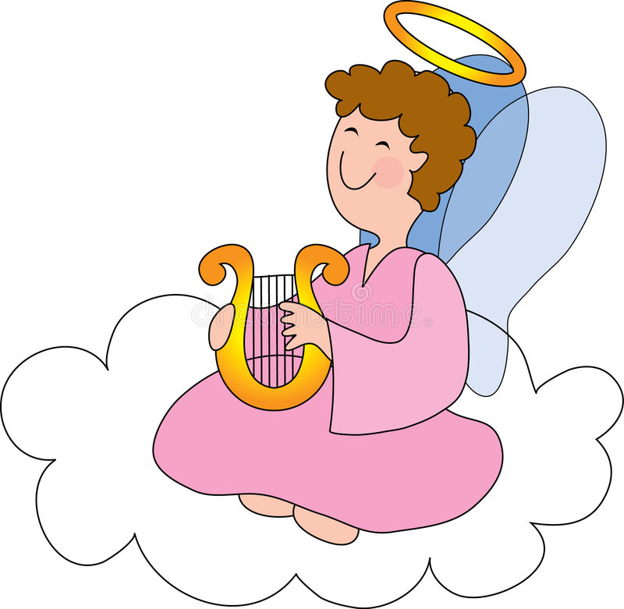

Slide 14
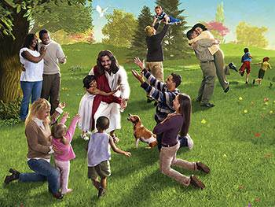

Slide 15
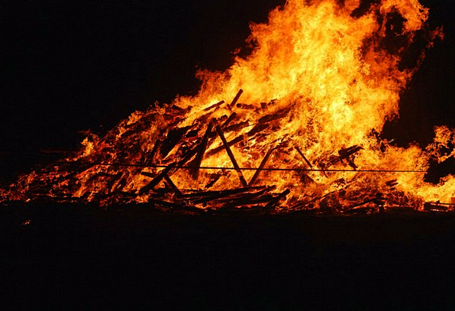

Slide 16
John 3:14-15
Just as Moses lifted up the snake
in the wilderness,
so the Son of Man must be lifted up,
that everyone who believes
may have eternal life in him.

Slide 17
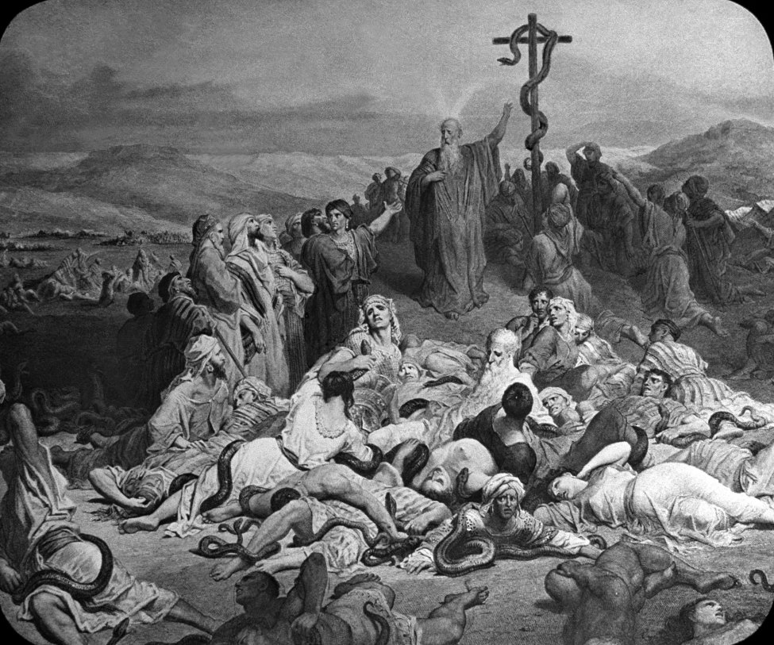

Slide 18
John 3:14-15
Just as Moses lifted up the snake
in the wilderness,
so the Son of Man must be lifted up,
that everyone who believes
may have eternal life in him.

Slide 19
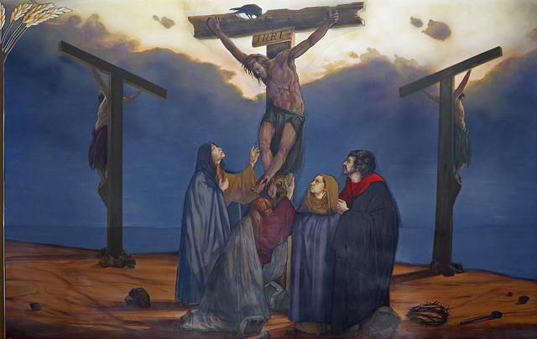

Slide 20
2 Corinthians 5:17 NASB
Therefore if anyone is in Christ,
he is a new creature;
the old things passed away;
behold, new things have come.

Slide 21
Philippians 3:20-21
Our citizenship is in heaven.
And we eagerly await a Savior
from there, the Lord Jesus Christ,
who, by the power that enables him
to bring everything under his control, will transform our lowly bodies
so that they will be like his
glorious body.

Slide 24
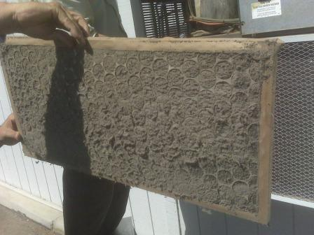

Slide 27
1 John 1:7
…walk in the light,
as He is in the light…

Slide 28
What it means to walk in the light:
Understand God’s perfect holiness. I John 1:5
Seek to live by God’s standard of perfect holiness. 1 John 2:28
Recognize when and how we sin.

Slide 29
What it means to walk in the light:
Confess our sins to God and to others. 1 John 1:9
Obtain God’s promised forgiveness
Repeat

Slide 30
Truth to Take Home
Those who truly know
God’s love in Christ
purify themselves in Him.

Slide 31
Challenge
Let God’s love in Christ
purify you of your sin.

