Slide 1
RIGHT, WRONG, OR IRRELEVANT?
Matthew 5:1-16

Slide 2
The Effect of Moral Upheaval
To muddy the waters regarding what is morally right and wrong
To call into question the validity of traditional Judeo-Christian moral teachings
To cause people to wonder if there even is such a thing as right or wrong.

Slide 3
Possible Responses
Cave-in

Slide 4
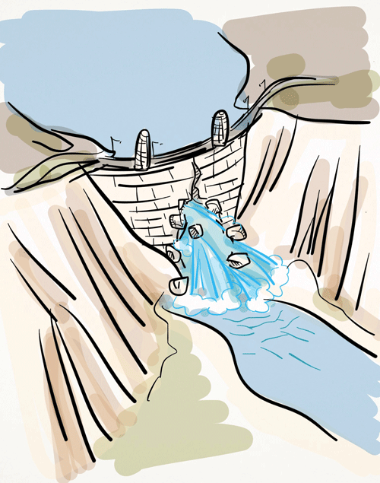

Slide 5
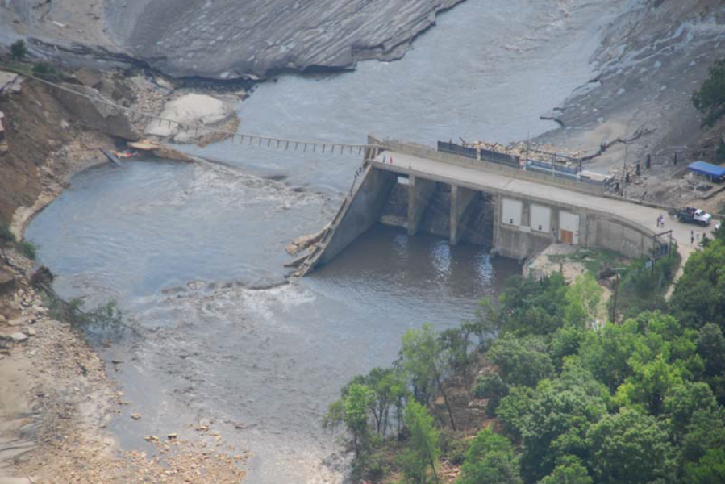

Slide 6
Possible Responses
Cave-in
Become a cave dweller

Slide 7
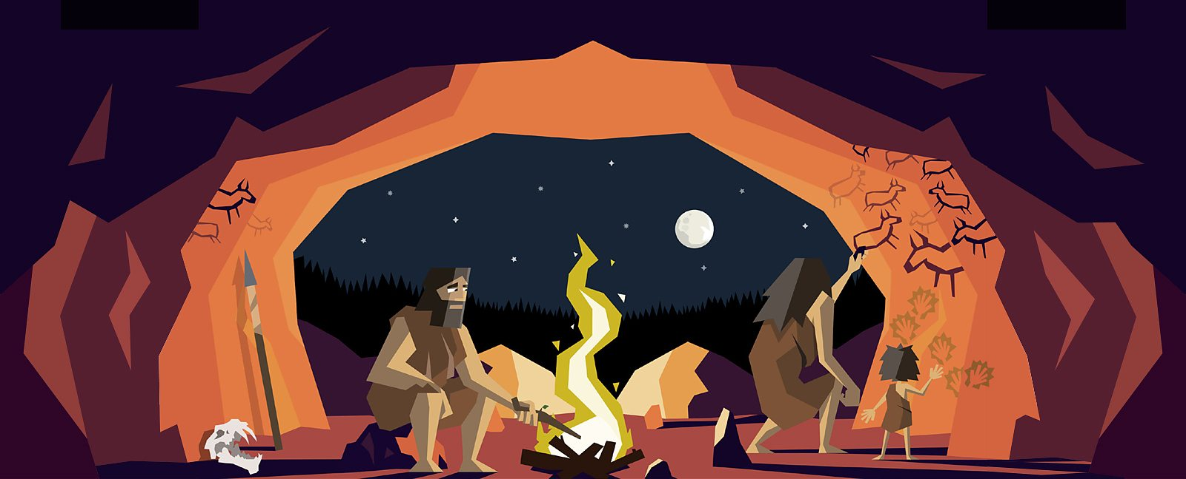

Slide 9
Possible Responses
Cave-in
Become a cave dweller
Become a beacon of light to people lost in the cave of moral darkness

Slide 11
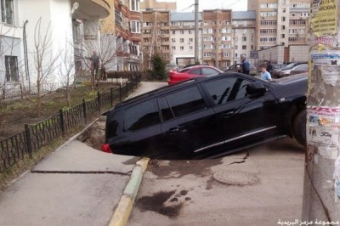

Slide 13
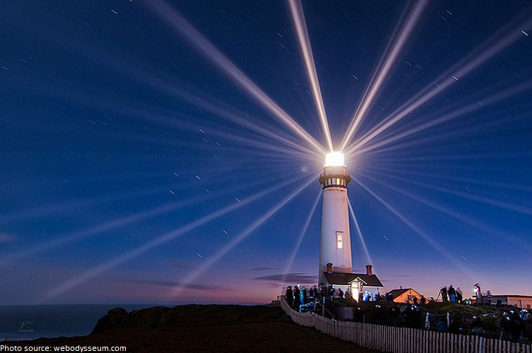

Slide 15
Matthew 5:16
In the same way,
let your light shine before others,
that they may see your good deeds
and glorify your Father in heaven.

Slide 16
Aims
To present the basic outlines of biblical Christian morality.
To make the case that knowing right from wrong is both valuable and important.
To help Christians live out the challenge of Matt. 5:16.

Slide 17
To Consider
Morality matters.
In the midst of a sea of changing opinions, the Word of God offers us a rock of stability with respect to the knowledge of what is right or wrong.
Christians and the Church have the opportunity to be a beacon of light to those who are lost in the darkness of moral chaos and sin.

Slide 18
Truth to Take Home
Jesus calls His followers to live moral lives,
and
to show others the right and godly way to live.

Slide 19
Challenge
Let your light shine before others,
that they may see your good deeds
and glorify your Father in heaven.

